Slide 1


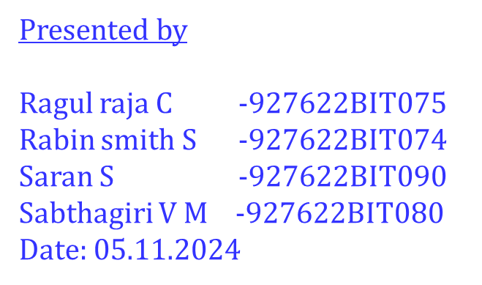
Identification of safe navigation routes on the Moon using Chandrayaan Images
First Review
Supervisor
Ms. Anitha K
Assistant Professor/ IT,
M. Kumarasamy College of Engineering,
Karur.

Slide 2
AGENDA
Abstract
Introduction
Literature Survey
Proposed idea
Module
Conclusion
References
First Review

Slide 3
Abstract
This project utilizes high-resolution images from Chandrayaan to identify and visualize a rover’s path on the Moon. Advanced image processing techniques, such as noise reduction, contrast enhancement, and feature extraction, are employed to highlight lunar surface features essential for navigation. Predictive models like Kalman filtering enable accurate path tracking across challenging terrain. Using GIS and data visualization tools, the rover's route is displayed interactively, offering a framework to support lunar exploration and analysis.
First Review

Slide 4
Introduction
The exploration of the lunar surface is challenging due to its rugged terrain and the need for precise navigation solutions for autonomous rovers. With advancements in space technology, the Chandrayaan missions have provided high-resolution images of the Moon’s surface, enabling detailed analysis of craters, ridges, and slopes. These features are crucial for mapping safe paths and avoiding obstacles during lunar exploration. However, converting this data into actionable navigation paths requires advanced image processing and predictive algorithms. This project aims to address these challenges by creating a robust pathfinding framework for lunar missions.
First Review

Slide 5
Introduction
The proposed framework uses Chandrayaan images to detect and visualize a rover's route across the lunar surface. By applying noise reduction, contrast enhancement, and feature-based detection, the project enhances essential lunar features for analysis. Predictive algorithms, like Kalman filtering and optical flow, are then employed to track and forecast the rover’s movement. The final path is displayed using GIS and data visualization tools, providing an interactive and real-time route view. This comprehensive approach aims to support future lunar exploration with a reliable and automated navigation solution.
First Review

Slide 6
Literature Survey
Paper Title | Publication details | Methodology | Results
An Efficient Approach to Image Denoising Using Deep Learning Methods | IEEE Transactions on Pattern Analysis and Machine Intelligence, 2015, Vol. 37, No. 3, pp. 511-525 | Utilizes deep learning models, specifically Faster R-CNN, for object detection and classification in images, incorporating region proposal networks (RPN) for better feature extraction. | Achieved superior accuracy in object detection tasks compared to traditional methods, with a faster inference time, enabling real-time object detection.
Enhanced Object Detection on Planetary Surfaces with Deep Learning | Journal of Planetary Science and Engineering, 2021, Vol. 15, No. 4, pp. 223-234. | Utilizes Faster R-CNN with region proposal networks (RPN) for detecting and classifying objects on planetary surfaces, including lunar features. | Achieved significant improvements in detection accuracy and precision for various surface objects, outperforming traditional methods in complex environments.
First Review

Slide 7
Proposed Idea
The proposed solution introduces a comprehensive path detection and visualization system using advanced lunar images, combining image processing with predictive tracking models. Unlike traditional methods, this approach incorporates deep learning for feature detection and machine learning for optimized path prediction, addressing the complexities of the lunar terrain. This framework offers improved accuracy in path mapping and integrates a visualization layer, allowing real-time interaction with the rover’s predicted route. This novel integration aims to set a new standard for lunar pathfinding.
First Review

Slide 8
Module 1: Image Acquisition and Preprocessing
This module involves collecting high-resolution lunar surface images from Chandrayaan datasets and preparing them for analysis. Initial preprocessing steps, including noise reduction through techniques like non-local means filtering and contrast enhancement with CLAHE, help improve image quality. Additionally, geometric corrections are applied to counter any distortions. These preprocessing steps enhance visibility of crucial lunar features, laying the foundation for accurate feature extraction.
First Review

Slide 9
Module 2: Feature Extraction
In this module, object detection methods identify critical lunar features such as craters, ridges, and obstacles that impact rover navigation. Techniques like template matching, as well as feature-based algorithms like SIFT or deep learning models (e.g., YOLO), are used to detect and classify these structures. These identified features are essential for informing path decisions, providing the rover with safe navigation routes across complex lunar terrain.
First Review

Slide 10
Module 3: Path Tracking and Prediction
Predictive models, including Kalman filters and optical flow algorithms, are applied in this module to trace and predict the rover's path across the Moon's surface. These methods enable continuous tracking by estimating motion between consecutive images, helping adapt the path to changing terrain. Additionally, machine learning techniques optimize the route by considering obstacles and lunar surface variations, resulting in a reliable navigation path.
First Review

Slide 11
Module 4: Visualization
This module presents the rover's detected and predicted path on the lunar surface using GIS and data visualization tools, such as QGIS and Matplotlib. The interactive visualization allows users to explore and analyze the rover’s route in both 2D and 3D, providing real-time insights into lunar navigation. This final output assists mission planners in making strategic navigation decisions and enhances understanding of the rover’s journey across the Moon.
First Review

Slide 12
Block Diagram
Input image
Pre processing
*Noise reduction
*contrast Adjustment
Enhancement Techniques
*Edge Detection
Output image
Post Processing
First Review

Slide 13
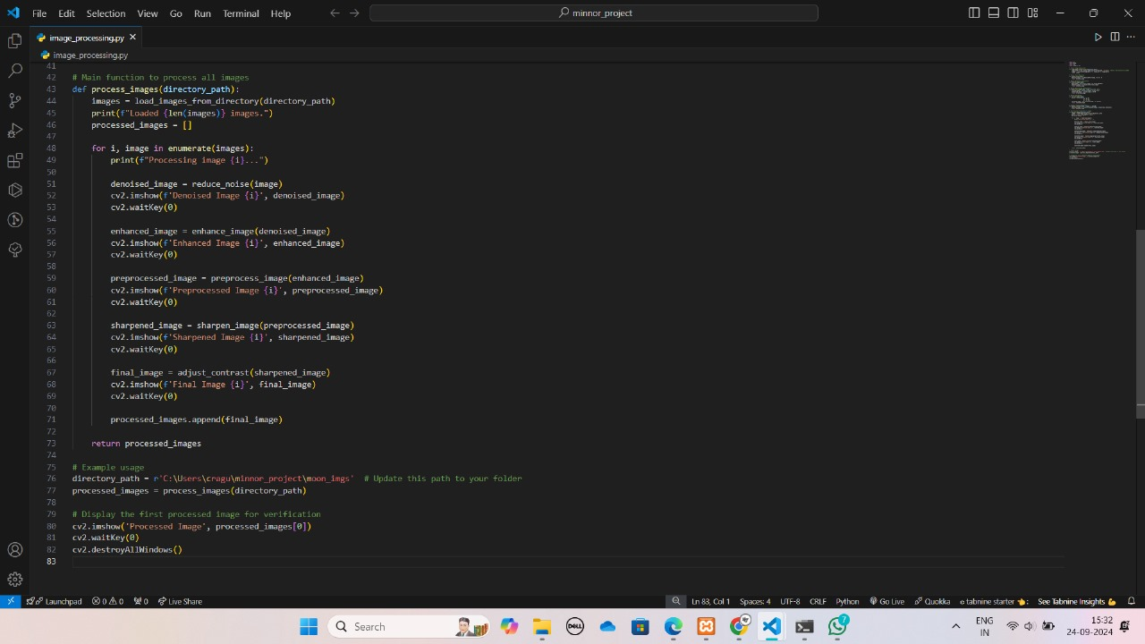
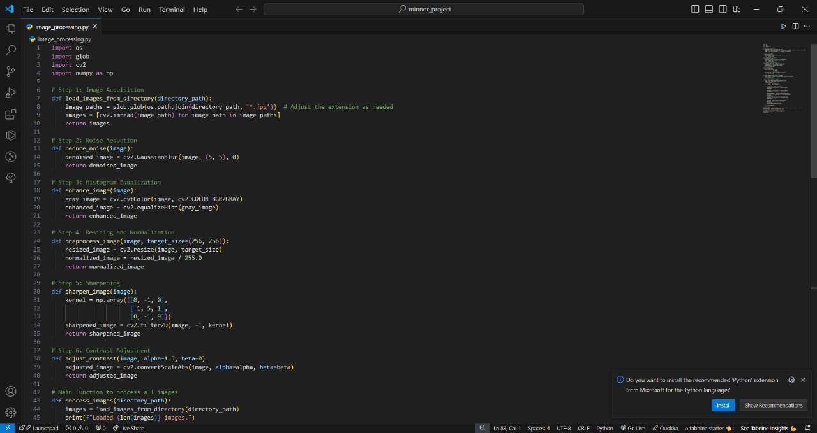
Module -1 coding
First Review

Slide 14
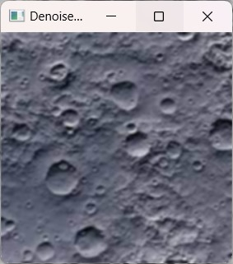
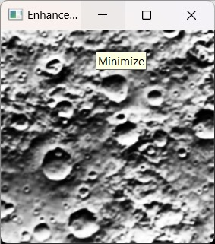
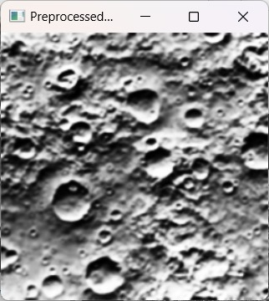
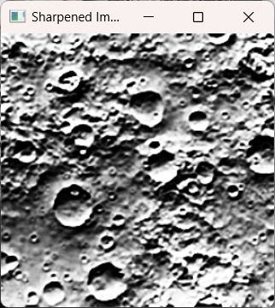
Screenshots
First Review

Slide 15
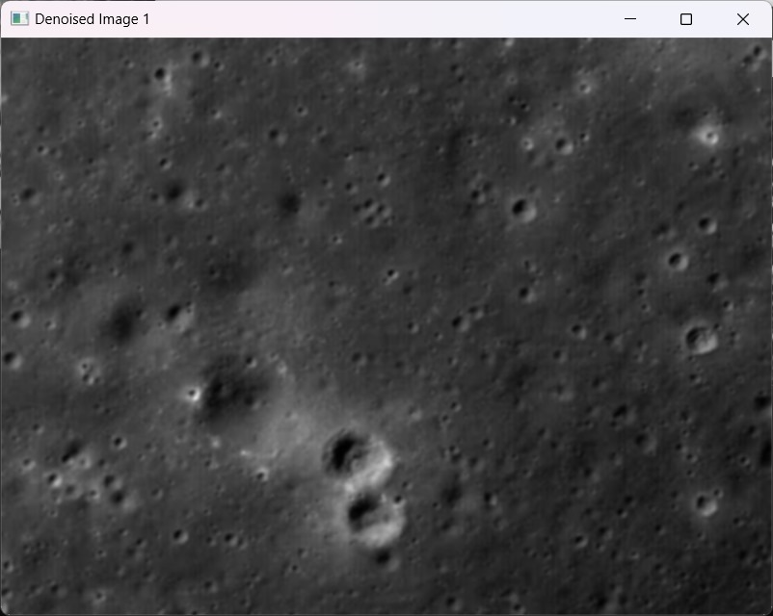
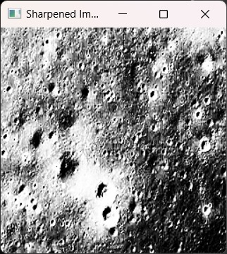
Test cases
First Review

Slide 16
Conclusion
Moon path detection using advanced image processing and deep learning techniques enables precise tracking and analysis of lunar surface features. Improved image quality and sophisticated detection methods provide valuable insights into lunar dynamics. This approach supports current exploration efforts and lays the groundwork for future missions.
First Review

Slide 17
References
https://arxiv.org/a
https://arxiv.org/abs/0905.0691bs/1506.01497
https://arxiv.org/abs/1506.01497
https://arxiv.org/abs/1506.02640
First Review

Slide 18
First Review

